Slide 1

Instagram User Analytics

Slide 2
Description
Imagine you're a data analyst working with the product team at Instagram. Your role involves analyzing user interactions and engagement with the Instagram app to provide valuable insights that can help the business grow.

Slide 3
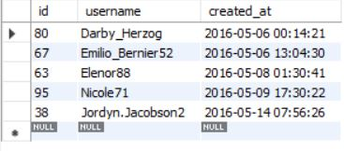
Marketing Analysis
Loyal User Reward
Using this query to find out the top 5 oldest user in instagram.

Slide 4
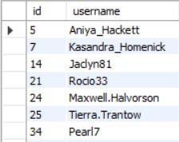
Marketing Analysis
Inactive User
Using this query to find out the user never posted a single photo on Instagram.

Slide 5


Marketing Analysis
CODE
Contest Winner
Using this query to find out the user with the most likes on a single photo in instagram.
Zack_kemmer is winner of the contest.
OUTPUT

Slide 6
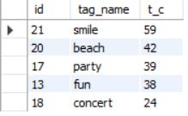
Marketing Analysis
###
Hashtag
Using this query to find out the top 5 hastag in instagram.
###

Slide 7

Marketing Analysis
Ad Campaign
Using this query to find out best day of the week.
Thursday, Sunday and Friday these three days most
users register on Instagram.

Slide 8

Investor Metrics
User Engagement
Using this query to find out the average number of posts per user on Instagram.

Slide 9

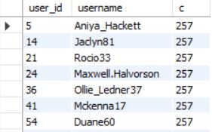
Investor Metrics
Bots & Fake Accounts
Instagram has a total of 100 accounts
Using this query to find out the who have liked every single photo on Instagram.
A total of 13 bots and fake accounts

Slide 10
Conclution
This analysis could help in making data-driven decisions, whether the platform is growing or became stagnant in its growth etc., by extracting meaningful insights from the data using MySQL Workbench tool.

